Slide 1
COMP 520 Advanced Database Systems
Database Introduction and Fundamental Concepts
Dr. Evren Eryilmaz

Slide 2
Table of Contents
Our approach to relational database
Definitions
Database examples
Database size and complexity
A spiral approach to database design
Components of a database system
DBMS products

Slide 3
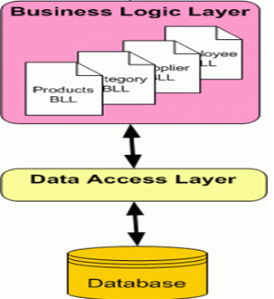
Our Approach to Relational Database Systems

Slide 4
Definitions
Data: Meaningful facts
Database: Organized collection of logically related data
Information: Data processed to be useful in decision making.

Slide 5


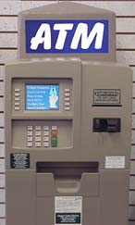
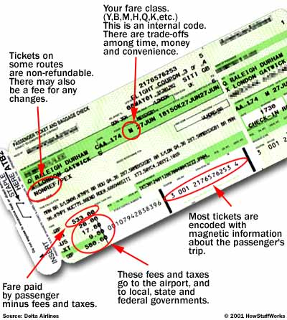

Database Examples
Medical records
Bank accounts
Stock market prices
Personnel systems
Product catalogues
Airline and hotel bookings
Student records
Customer histories
Discussion boards

Slide 6
Database Size and Complexity
Database | Example User | Number of Users | Typical Size
Sales contact manager | Salesperson | 1 | 2,000 rows
Patient appointment | Medical office | 15 to 50 | 100,000 rows
Enterprise resource planning (ERP) | An entire organization | 5,000 | 10 million + rows
E-commerce site | Internet users | Possibly millions | 1 billion + rows
Data mining (Data warehouse) | Data scientist, Business analyst… | 25 | 100,000 to millions+

Slide 7
A Spiral Approach to Database Design
Databases arise from three sources:
Existing Data
Development of new information systems projects
The need to redesign an existing database to adopt to changing requirements
Notes:
The first type of database design involves databases that are constructed from existing data.

Slide 8
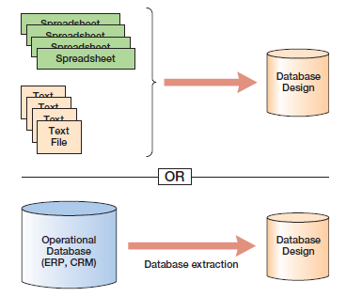
Database Design from Existing Data

Slide 9
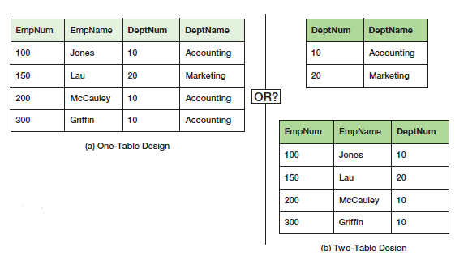
Database Design from Existing Data

Slide 10
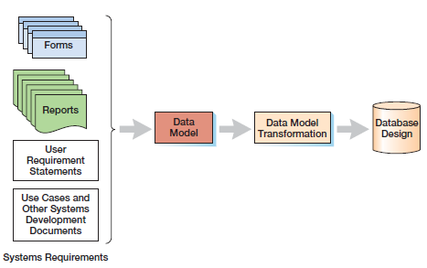
Database Design from New Systems Development
Notes:
Data Model is perhaps the most important thing here.

Slide 11
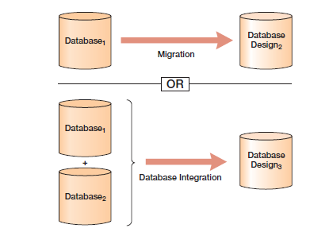
Database Design from Redesign

Slide 12
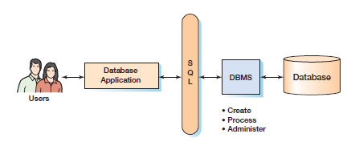
Components of a database system
Notes:
A database system consists of five components: users, database application, structured query language (SQL), database management system (DBMS), and database.

Slide 13
Metadata
Data that describes the properties or characteristics of other data
Does not include sample data
Allows database designers and users to understand the meaning of the data

Slide 14
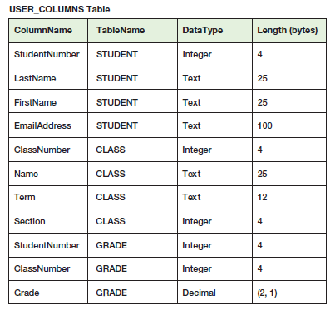
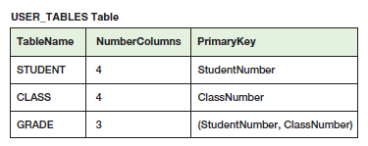
Metadata Table Examples
Notes:
The example on the left indicates that there are 3 tables in a database. These tables have the names: student, class, and grade. The metadata tables shows the number of columns and primary key of each table. Primary key refers to the field or fields that uniquely identifies other fields in a table.
We can examine metadata to determine if particular tables, columns, indexes or other structures exist in a database.

Slide 15
Database Contents
Tables of user data
Metadata
Index
Stored procedures
Triggers
Security data
Backup/recovery data
Notes:
In addition to user tables and metadata, databases contain other elements listed here.
An index is a structure that speeds the sorting and searching of database data. For example, assume that we have an employee table with 10,000 rows and we want to search for a particular row. To improve performance, we can create indexes.
Triggers and stored procedures are programs that are stored within a database. We use triggers to maintain database accuracy and consistency and enforce data constraints.
Stored procedures are used for database administration tasks and are sometimes part of database applications.
Security data defines users, groups, and allowed permission for users and groups.
Finally, backup and recovery data are used to save database data to backup devices as well as to recover the database after a failure.

Slide 16
DBMS Component
Notes:
The second component in a database is database management system or DBMS in short. The DBMS manages the database.

Slide 17
DBMS Functions
Create database
Create tables
Create supporting structures (e.g., indexes)
Read database data
Modify (insert, update, or delete) database data
Maintain database structures
Enforce rules
Control concurrency
Provide security
Perform backup and recovery

Slide 18
DBMS Products
Microsoft Access
MySQL->Phpmyadmin
Microsoft SQL Server
Oracle
Notes:
There are a number of DBMS products available in the market. For the purpose of our class, we will be using Access. However, it is important to discuss the characteristics of the other prominent products as well.

Slide 19
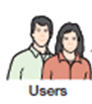
Microsoft Access
Data Entry Forms
Database
Reports
Microsoft Access
Queries

Slide 20
MySQL->Phpmyadmin
Open-source DBMS product
Its popularity for use with web applications is closely tied to the popularity of PHP
Supports triggers, stored procedures
Continually being updated

Slide 21
Microsoft SQL Server
Robust enterprise level DBMS product (a few hundred gigabytes)
Good for database driven websites
SQL server supports vertical scalability
Enterprise manager and query analyzer can be used to learn SQL, triggers, and stored procedures
Notes:
SQL server uses a sybase-derived engine. However, Sql Server only works on the Windows operating system.

Slide 22
Oracle
Superb for large scale databases (Organizational level)
Supports both horizontal and vertical scalability
Oracle works on both Microsoft Windows and Unix operating systems
Oracle’s SQL Plus is a handy tool to learn SQL, triggers, and stored procedures
Notes:
Oracle works on both Microsoft Windows and Unix operating systems.
Challenge: Oracle is difficult to install

Slide 23
SQL Component
Notes:
SQL is the third component of a database system. SQL stands for structured query language. This is a data sublanguage because it has only those statements needed for creating and processing database data and metadata. All database products process SQL. We can use SQL statements in many different ways. For instance, we can submit them directly to the DBMS for processing. Thus, it is the DBMS that processes SQL statements. As an alternative we can embed SQL statements into web pages for reporting or data extraction purposes.

Slide 24
Sample SQL Statement
SELECT StudentName, EmailAddress
FROM STUDENT
WHERE StudentNumber > 200;
Notes:
To give you an idea, this is a simple SQL statement for processing the Student table.
The SQL statement will obtain the name and email address of all students having a student number greater than 200.

Slide 25
Database Application

Slide 26
Users

